Slide 1
Do The First Works Worthy of Repentance
Ludwig
20/05/2018

Slide 2
1 Peter 2:9-10
⁹ But you are a chosen generation,
a royal priesthood,
a holy nation,
His own special people,
that you may proclaim the praises of Him who called you out of darkness
into His marvelous light;
¹⁰ who once were not a people but are now the people of God, who had not obtained mercy but now have obtained mercy.

Slide 3
Titus 2:11-15
¹¹ For the grace of God that brings salvation has appeared to all men,
¹² teaching us that, denying ungodliness and worldly lusts, we should live soberly, righteously, and godly in the present age,
¹³ looking for the blessed hope and glorious appearing of our great God and Savior Jesus Christ,
¹⁴ who gave Himself for us, that He might redeem us from every lawless deed and purify for Himself His own special people, zealous for good works

Slide 4
Works?
Repent from dead works (Hebrews 6:1-2)
Not saved by works (Eph 2:8-10)
Yet created in Christ Jesus for Good works (Titus 2:11-15)
What are these good works?

Slide 5
Romans 12:1-2
¹ I beseech you therefore, brethren, by the mercies of God, that you present your bodies a living sacrifice, holy, acceptable to God, which is your reasonable service (worship).
² And do not be conformed to this world, but be transformed by the renewing of your mind, that you may prove what is that good and acceptable and perfect will of God.

Slide 6
Revelation 2:1-7
¹“To the angel of the church of Ephesus write,
‘These things says He who holds the seven stars in His right hand, who walks in the midst of the seven golden lampstands:
² “I know your works, your labor, your patience, and that you cannot bear those who are evil. And you have tested those who say they are apostles and are not, and have found them liars;
³ and you have persevered and have patience, and have labored for My name’s sake and have not become weary.
⁴ Nevertheless I have this against you, that you have left your first love.

Slide 7
⁵ Remember therefore from where you have fallen; repent and do the first works, or else I will come to you quickly and remove your lampstand from its place—unless you repent.
⁶ But this you have, that you hate the deeds of the Nicolaitans, which I also hate.
⁷ “He who has an ear, let him hear what the Spirit says to the churches. To him who overcomes I will give to eat from the tree of life, which is in the midst of the Paradise of God.” ’

Slide 8
Remember or Recognise where we have fallen (First Love, First Works)
Repentance (Change of mind – Rom 12:2)
Do Works worthy of Repentance

Slide 9
1. Remember or Recognise where we have fallen (First Love, First Works)
The first works has to do with leaving the first love.
Jesus is our first Love.
Do the First works
Present yourself in consecration, devotion
in intimacy
1 John 4:19
¹⁹ We love Him because He first loved us.

Slide 10
First Works
Exodus 7:16
¹⁶ And you shall say to him, ‘The Lord God of the Hebrews has sent me to you, saying, “Let My people go, that they may serve Me in the wilderness”; but indeed, until now you would not hear!
Exodus 25 – The Tabernacle of Moses
Numbers 4 – Service, Duty, Work of the Tabernacle
We are a temple of the Holy Spirit
The church is the House of God, God’s dwelling place.
Present our bodies - Daily Ministration

Slide 11
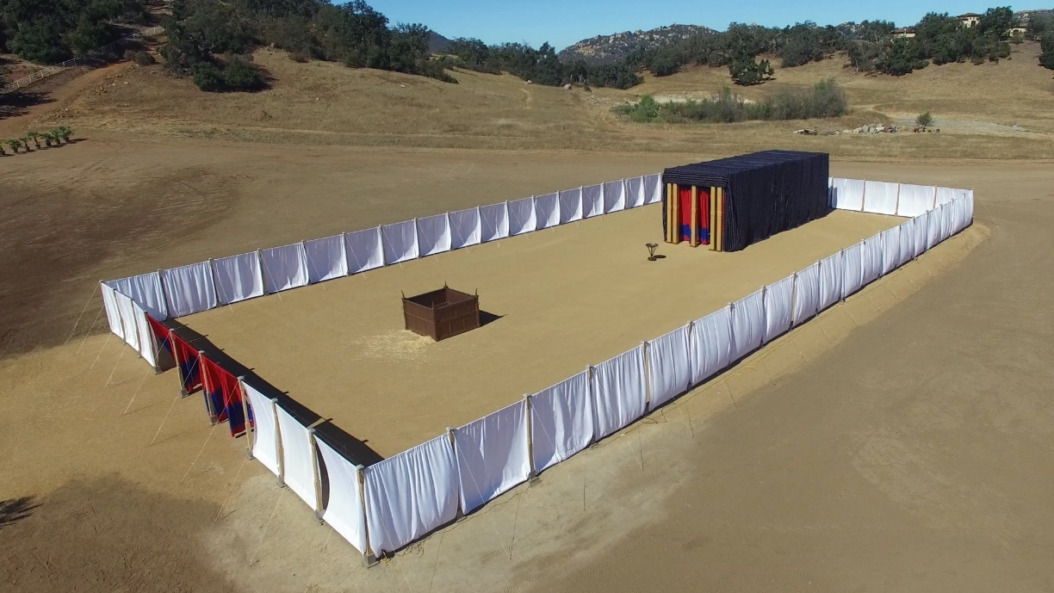
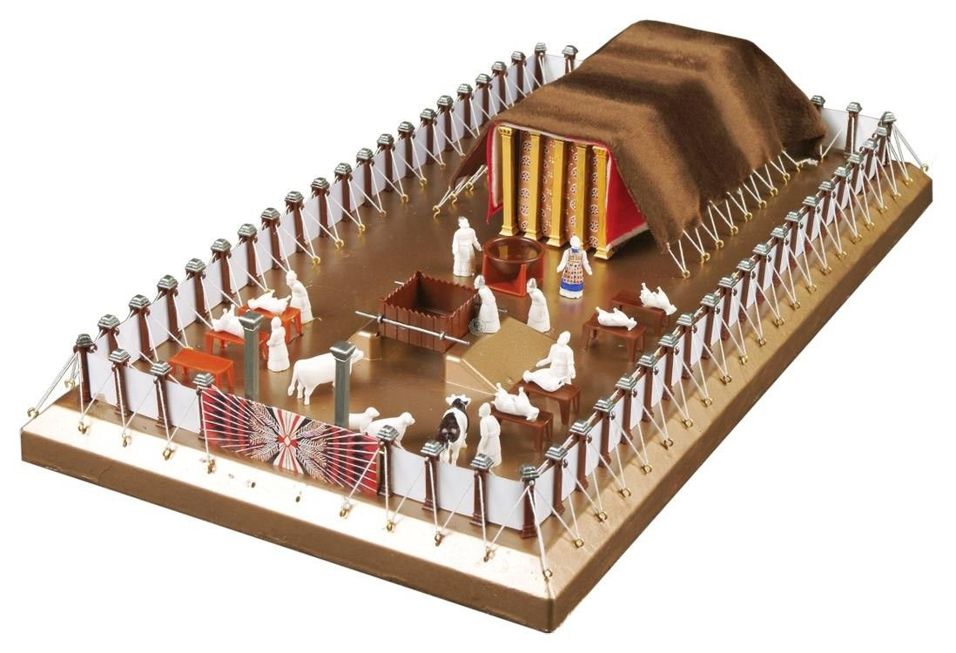
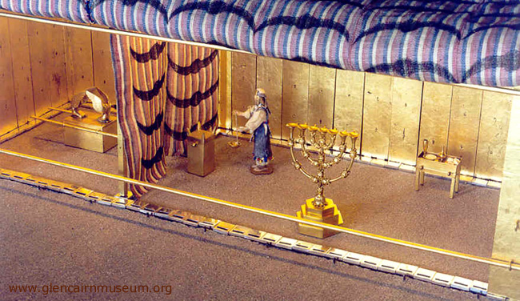

Slide 12
2. Repentance
Romans 12:1-2
¹ I beseech you therefore, brethren, by the mercies of God, that you present your bodies a living sacrifice, holy, acceptable to God, which is your reasonable service (worship).
² And do not be conformed to this world, but be transformed by the renewing of your mind, that you may prove what is that good and acceptable and perfect will of God.
Verse 1 Surrender, yieldedness, consecration, devotion (First Love)
Verse 2 - Repentance

Slide 13
3. Do Works worthy of Repentance
James 1:21-25
²¹ Therefore lay aside all filthiness and overflow of wickedness, and receive with meekness the implanted word, which is able to save your souls.
²² But be doers of the word, and not hearers only, deceiving yourselves.
²³ For if anyone is a hearer of the word and not a doer, he is like a man observing his natural face in a mirror;

Slide 14
²⁴ for he observes himself, goes away, and immediately forgets what kind of man he was.
²⁵ But he who looks into the perfect law of liberty and continues in it, and is not a forgetful hearer but a doer of the work, this one will be blessed in what he does.

Slide 15
1 Corinthians 2:1-5
¹ And I, brethren, when I came to you, did not come with excellence of speech or of wisdom declaring to you the testimony of God. ² For I determined not to know anything among you except Jesus Christ and Him crucified. ³ I was with you in weakness, in fear, and in much trembling. ⁴ And my speech and my preaching were not with persuasive words of human wisdom, but in demonstration of the Spirit and of power, ⁵ that your faith should not be in the wisdom of men but in the power of God.
Fruit and the Gift of the Spirit

Slide 16
Galatians 5:22-23
²² But the fruit of the Spirit is love, joy, peace, longsuffering, kindness, goodness, faithfulness,
²³ gentleness, self-control. Against such there is no law.

Slide 17
Philippians 2:12-13
¹² Therefore, my beloved, as you have always obeyed, not as in my presence only, but now much more in my absence, work out your own salvation with fear and trembling;
¹³ for it is God who works in you both to will and to do for His good pleasure.

Slide 18
Remember or Recognise Where we have fallen (First Love)
Repentance (Change of mind)
Do Works worthy of Repentance

